Slide 1
CREATE A COMPOSITE MODEL
BY NITIN

Slide 2

OBJECTIVES
Unlike other labs focused on individual storage modes, this lab teaches how to combine DirectQuery and Import modes in a single model.
I learned to add and configure aggregation tables to optimize performance.

Slide 3
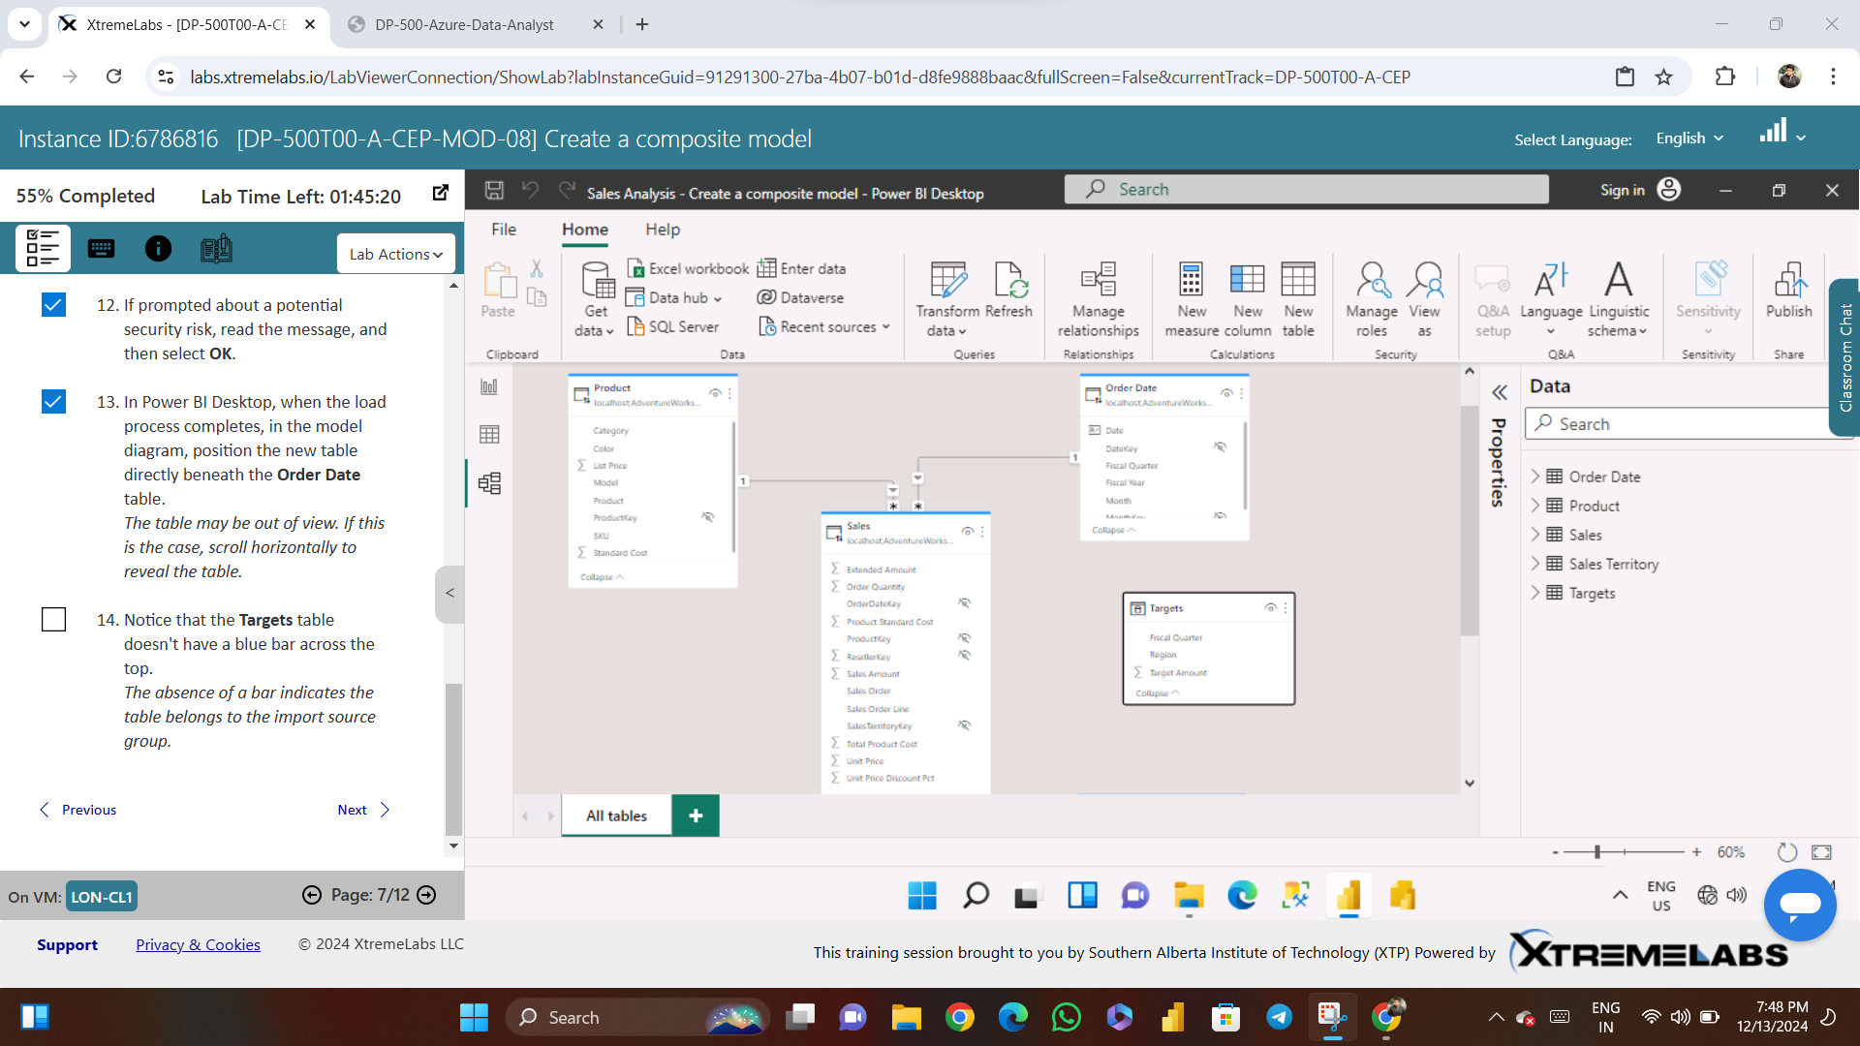

Slide 4
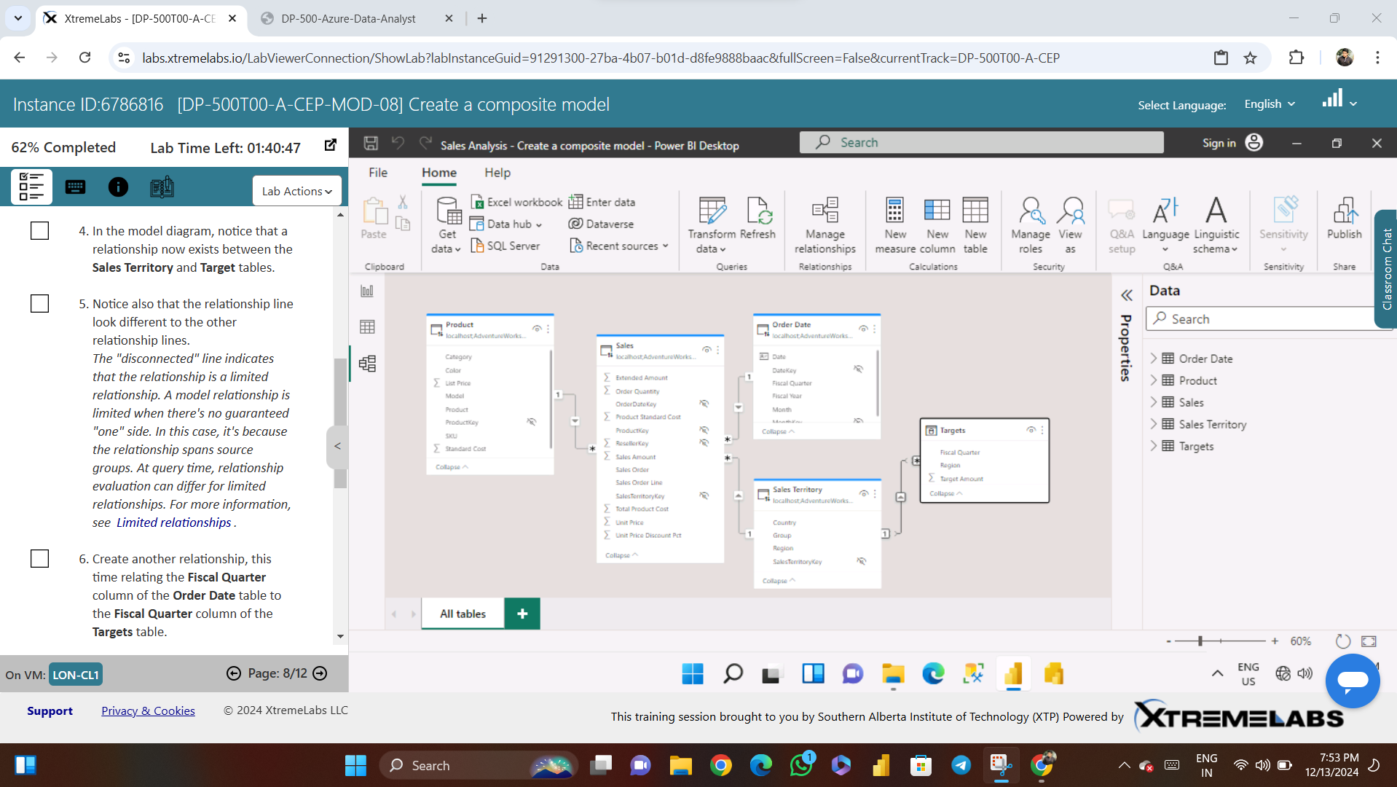

Slide 5
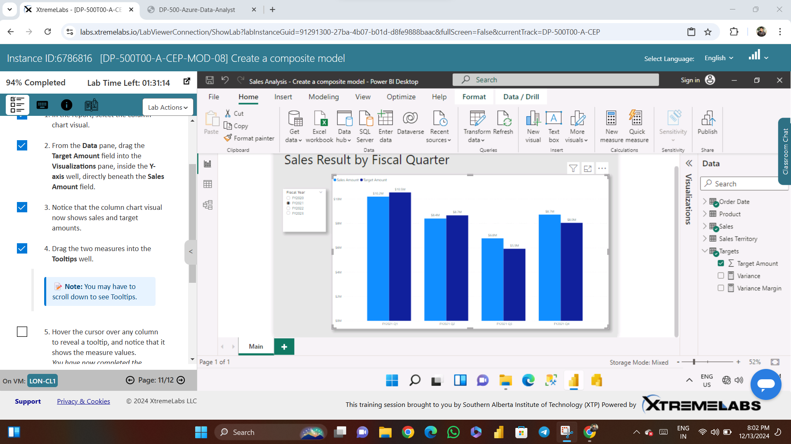

Slide 6
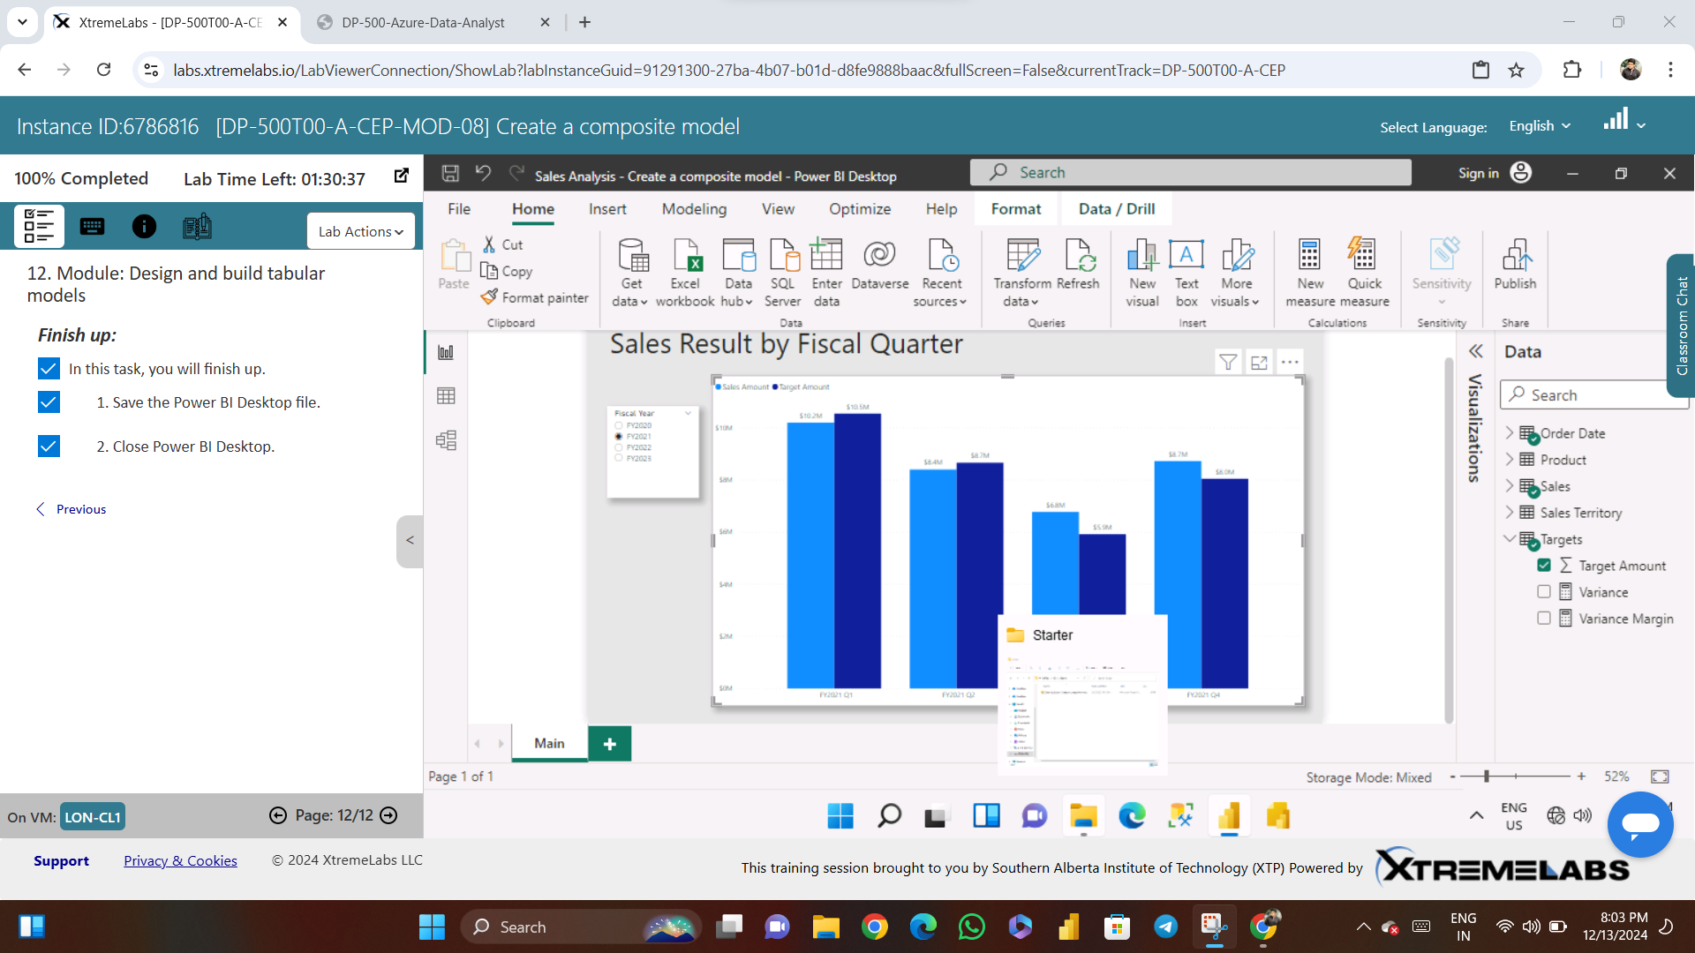

Slide 7
